Slide 1
Project 1:
Corona Virus Analysis
Testing SQL and data analysis skills in a real-world context
Presenter: Anagha P

Slide 2
Aim and Overview of the Project
01
Corona Virus pandemic impact on public health
Urgent need for data-driven insights
Understanding the spread of the virus
This project involves analyzing a COVID-19 dataset using SQL and data analysis skills. The task is to derive insights from the dataset containing information such as geographic location, dates, confirmed cases, deaths, and recoveries.
02
Tasked with analyzing a Corona Virus dataset
Deriving meaningful insights
Presenting findings

Slide 3
The virus has spread rapidly across continents, overwhelming healthcare systems.
Millions have been infected, resulting in significant strain on hospitals and healthcare workers.
Mortality rates have risen, causing immense loss and grief globally.
Overview:
Key statistics and trends highlighting the severity of the crisis:
High infection rates in densely populated areas.
Variants of the virus contributing to increased transmissibility and severity.
Global Impact on Public Health

Slide 4

Importance of Data-Driven Insights
The critical role of data-driven insights in addressing the challenges posed by the pandemic
Data analysis helps identify hotspots, track transmission patterns, and predict future outbreaks.
Real-time data informs decision-making for implementing public health measures like lockdowns and vaccination strategies.
Data-driven modeling enables healthcare systems to allocate resources efficiently and plan for surges in cases.
T
TRACK
LOCKDOWN
D
W
How data analysis can inform decision-making, resource allocation, and public health interventions to mitigate the spread of the virus:
DATA
V
By analyzing demographic data, authorities can target vaccination campaigns and public health messaging.
Contact tracing data helps identify and isolate individuals at risk of spreading the virus.
Surveillance data aids in monitoring the effectiveness of control measures and adjusting strategies accordingly.
VACCINATION

Slide 5
Dataset Overview
Utilizing this Corona Virus dataset provides a comprehensive understanding of the pandemic's spread and its impact on different regions, aiding in effective decision-making and resource allocation.
Columns include:
Province: Geographic subdivision within a country/region.
Country/Region: Geographic entity where data is recorded.
Latitude: North-south position on Earth's surface.
Longitude: East-west position on Earth's surface.
Date: Recorded date of CORONA VIRUS data.
Confirmed: Number of diagnosed CORONA VIRUS cases.
Deaths: Number of CORONA VIRUS related deaths.
Recovered: Number of recovered CORONA VIRUS cases.

Slide 6
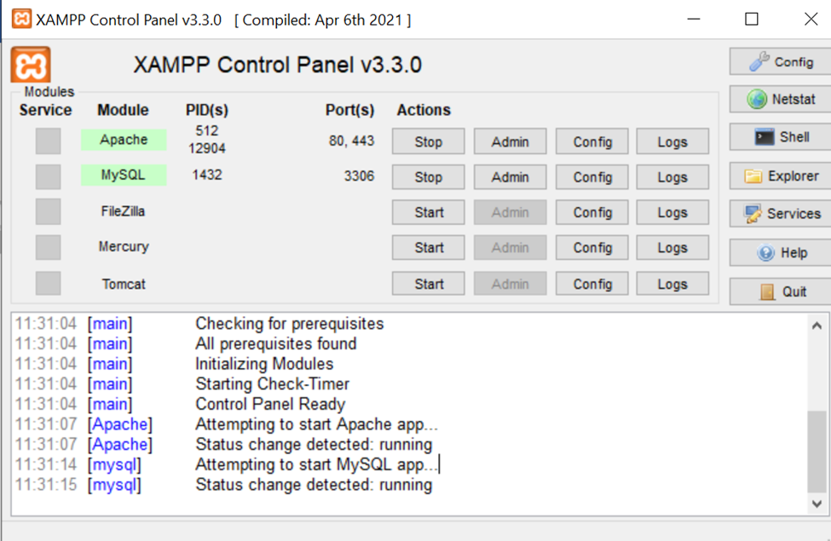
SQL: The full form of SQL is Structured Query Language. SQL is a program created and formulated in the Relational Database Management System to handle structured data.
XAMPP: XAMPP is a free, open-source web server solution stack that includes Apache, MySQL, PHP, and Perl. It works on all major operating systems, including Windows, Mac, and Linux. XAMPP also includes phpMyAdmin, a PHP-based software for managing MySQL databases.
BEFORE DIVING INTO CORONA VIRUS ANALYSIS

Slide 7
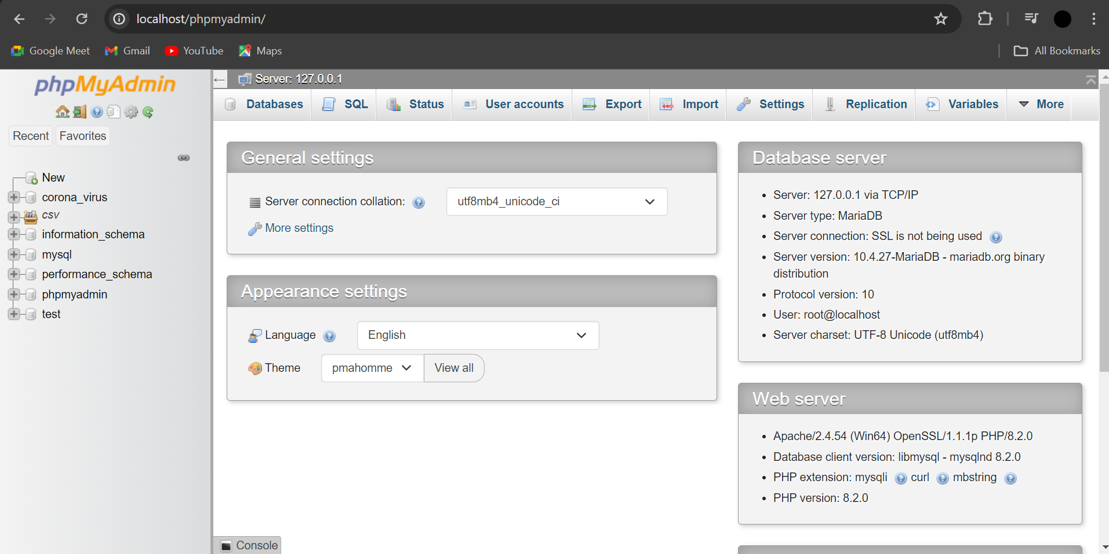
Accessing MySQL using XAMPP Control Panel:
Open the XAMPP Control Panel and Start both Apache and MySQL
Open a web browser (E.g. Google Chrome, Firefox etc..) and search ‘local host’
Thus we’ll be able to access a wide range of options on MariaDB and MySQL
BEFORE DIVING INTO CORONA VIRUS ANALYSIS

Slide 8
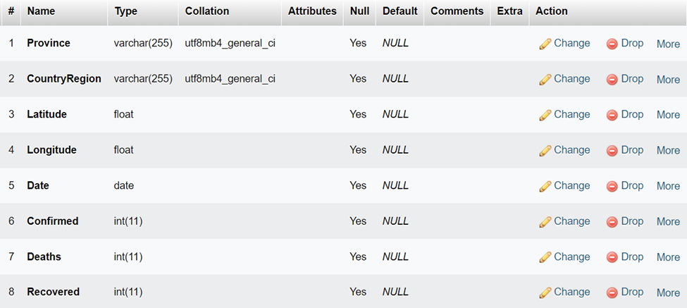

Creating a Database & Table
Enter the Following Queries:
#creating database
CREATE DATABASE corona_virus
#creating a null table
CREATE TABLE coviddata5 (
Province VARCHAR(255),
CountryRegion VARCHAR(255),
Latitude FLOAT,
Longitude FLOAT,
Date DATE,
Confirmed INT,
Deaths INT,
Recovered INT
);

Slide 9
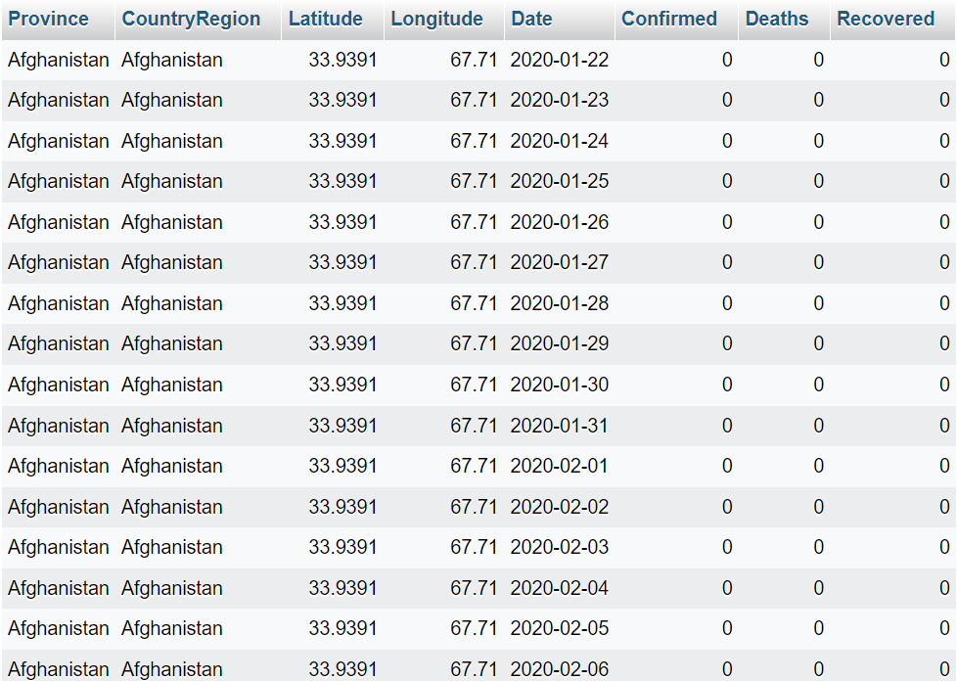

Importing from csv
#importing from csv
LOAD DATA INFILE "C:/Users/ADMIN/Downloads/Corona Virus Dataset (1).csv"
INTO TABLE coviddata5
FIELDS TERMINATED BY ',' ENCLOSED BY '"'
LINES TERMINATED BY '\n'
IGNORE 1 LINES
(Province, CountryRegion, Latitude, Longitude, @Date, Confirmed, Deaths, Recovered)
SET Date = STR_TO_DATE(@Date, '%d-%m-%Y');

Slide 10

Q1. Write a code to check NULL values.
SELECT *
FROM coviddata5
WHERE Province IS NULL
OR 'Country/Region' IS NULL
OR Latitude IS NULL
OR Longitude IS NULL
OR Date IS NULL
OR Confirmed IS NULL
OR Deaths IS NULL
OR Recovered IS NULL;
INFERENCE: There are no null values present in the data set

Slide 11
Q2. If NULL values are present, update them with zeros for all columns.
UPDATE coviddata5
SET
Province = COALESCE(Province, ''),
`Country/Region` = COALESCE(`Country/Region`, ''),
Latitude = COALESCE(Latitude, 0),
Longitude = COALESCE(Longitude, 0),
Date = COALESCE(Date, ''),
Confirmed = COALESCE(Confirmed, 0),
Deaths = COALESCE(Deaths, 0),
Recovered = COALESCE(Recovered, 0);
INFERENCE: Since there are 0 null values in the dataset 0 rows are affected

Slide 12
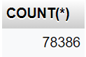
Q3. Check total number of rows.
SELECT COUNT(*) FROM coviddata5;
INFERENCE: There are 78386 rows

Slide 13
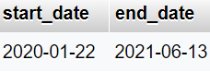
Q4. Check what is start_date and end_date.
SELECT MIN(Date) AS `start_date`,MAX(Date) AS `end_date` FROM coviddata5;

Slide 14
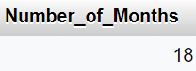
Q5. Number of month present in dataset
SELECT COUNT(DISTINCT DATE_FORMAT(Date, '%Y-%m')) AS Number_of_Months FROM coviddata5;

Slide 15
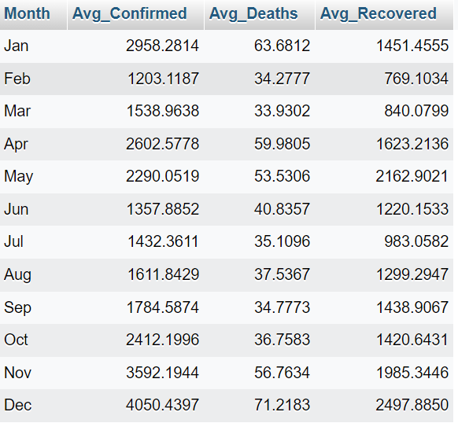
Q6. Find monthly average for confirmed, deaths, recovered
SELECT
DATE_FORMAT(Date, '%b') AS Month,
AVG(Confirmed) AS Avg_Confirmed,
AVG(Deaths) AS Avg_Deaths,
AVG(Recovered) AS Avg_Recovered
FROM
coviddata5
GROUP BY
MONTH(Date)
ORDER BY
MONTH(Date);

Slide 16
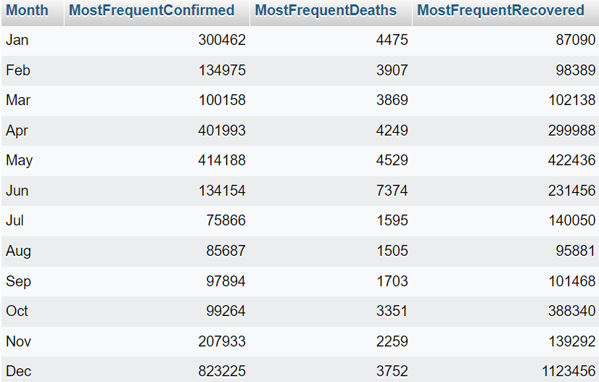
Q7. Find most frequent value for confirmed, deaths, recovered each month
SELECT
DATE_FORMAT(Date, '%b') AS Month,
MAX(Confirmed) AS MostFrequentConfirmed,
MAX(Deaths) AS MostFrequentDeaths,
MAX(Recovered) AS MostFrequentRecovered
FROM
coviddata5
GROUP BY
MONTH(Date)
ORDER BY
MONTH(Date);

Slide 17
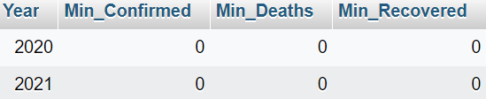
Q8. Find minimum values for confirmed, deaths, recovered per year
SELECT
YEAR(Date) AS Year,
MIN(Confirmed) AS Min_Confirmed,
MIN(Deaths) AS Min_Deaths,
MIN(Recovered) AS Min_Recovered
FROM
coviddata5
GROUP BY
YEAR(Date);

Slide 18
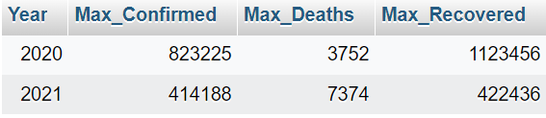
Q9. Find maximum values of confirmed, deaths, recovered per year
SELECT
YEAR(Date) AS Year,
MAX(Confirmed) AS Max_Confirmed,
MAX(Deaths) AS Max_Deaths,
MAX(Recovered) AS Max_Recovered
FROM
coviddata5
GROUP BY
YEAR(Date);

Slide 19
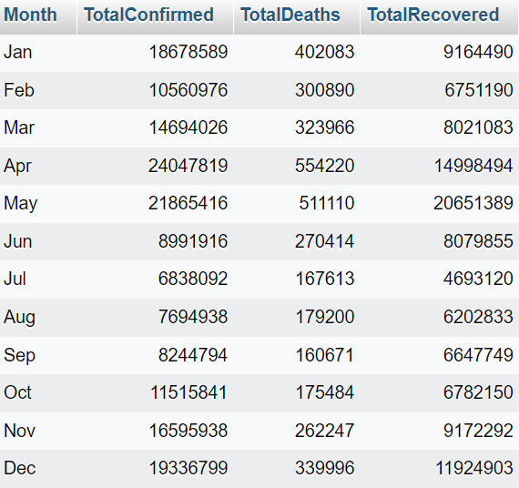
Q10. The total number of case of confirmed, deaths, recovered each month
SELECT
DATE_FORMAT(Date, '%b') AS Month,
SUM(Confirmed) AS TotalConfirmed,
SUM(Deaths) AS TotalDeaths,
SUM(Recovered) AS TotalRecovered
FROM
coviddata5
GROUP BY
MONTH(Date)
ORDER BY
MONTH(Date);

Slide 20
Q11. Check how corona virus spread out with respect to confirmed case
(Eg: total confirmed cases, their average, variance & STDEV )
SELECT
COUNT(*) AS TotalConfirmedCases,
AVG(Confirmed) AS AverageConfirmedCases,
VARIANCE(Confirmed) AS ConfirmedVariance,
STDDEV(Confirmed) AS ConfirmedStandardDeviation
FROM
coviddata5;

Slide 21
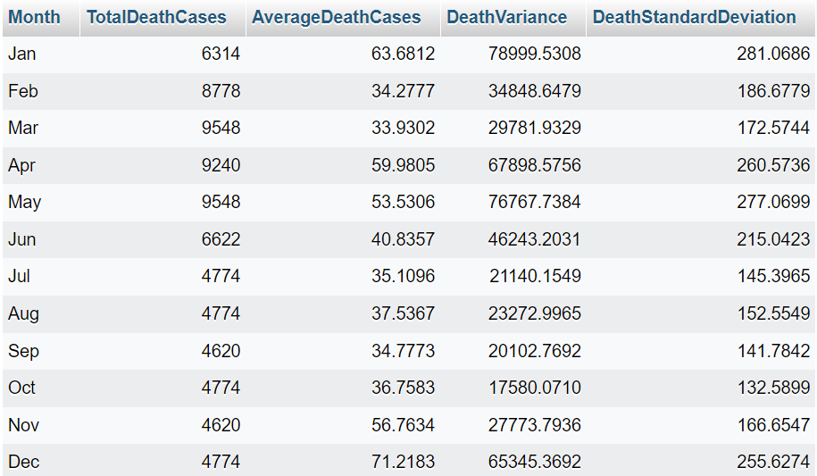
Q12. Check how corona virus spread out with respect to death case per month
(Eg: total confirmed cases, their average, variance & STDEV )
SELECT
DATE_FORMAT(Date, '%b') AS Month,
COUNT(*) AS TotalDeathCases,
AVG(Deaths) AS AverageDeathCases,
VARIANCE(Deaths) AS DeathVariance,
STDDEV(Deaths) AS DeathStandardDeviation
FROM
coviddata5
GROUP BY
MONTH(Date)
ORDER BY
MONTH(Date);

Slide 22

Q13. Check how corona virus spread out with respect to recovered case
(Eg: total confirmed cases, their average, variance & STDEV )
SELECT
COUNT(*) AS TotalRecoveredCases,
AVG(Recovered) AS AverageRecoveredCases,
VARIANCE(Recovered) AS RecoveredVariance,
STDDEV(Recovered) AS RecoveredStandardDeviation
FROM
coviddata5;

Slide 23
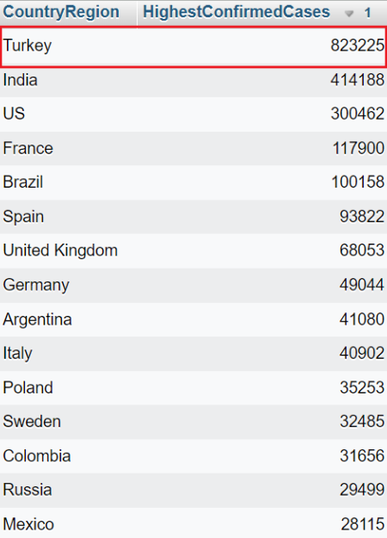
Q14. Find Country having highest number of the Confirmed case
SELECT
CountryRegion,
MAX(Confirmed) AS HighestConfirmedCases
FROM
coviddata5
GROUP BY
CountryRegion
ORDER BY
HighestConfirmedCases DESC;
INFERENCE: Thus Turkey has the highest Confirmed Cases

Slide 24
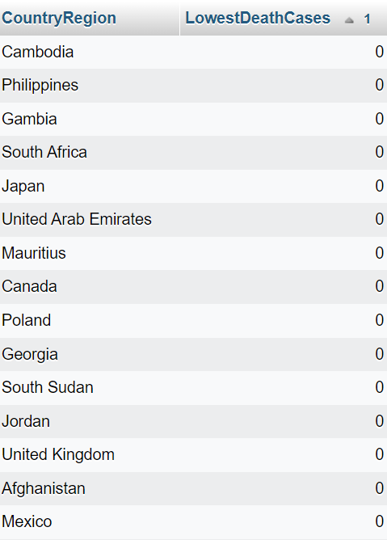
Q15. Find Country having lowest number of the death case
SELECT
CountryRegion,
MIN(COALESCE(Deaths, 0)) AS LowestDeathCases
FROM
coviddata5
GROUP BY
CountryRegion
ORDER BY
LowestDeathCases ASC;

Slide 25
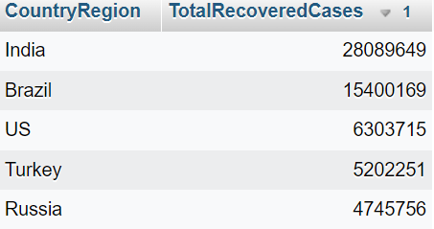
Q16. Find top 5 countries having highest recovered case
SELECT
CountryRegion,
SUM(Recovered) AS TotalRecoveredCases
FROM
coviddata5
GROUP BY
CountryRegion
ORDER BY
TotalRecoveredCases DESC
LIMIT 5;

Slide 26
Conclusion
Key Findings
Implications
Summarized the spread of COVID-19 through data analysis.
Identified trends in confirmed cases, deaths, and recoveries.
Highlighted countries with the highest and lowest case numbers.
Data-driven insights
Importance of ongoing data analysis for monitoring and response efforts.
1
2
3
4
5
Limitations
Future Directions
Key Takeaways
Data quality and completeness may affect analysis accuracy.
Scope limited to available dataset and analytical methods.
Explore additional datasets for comprehensive analysis.
Consider longitudinal studies to track trends over time..
Data analysis essential for understanding complex public health crises.
Continuous monitoring and analysis crucial for effective response..

Slide 27
THANK YOU
Testing SQL and data analysis skills in a real-world context

